Slide 1
ECE 3436 Microprocessor Systems Notes 10a: Special Purpose Registers
Ph.D. Jianfeng Zheng
Dept. ECE, Univ. of Houston
Email: jzheng4@central.uh.edu
Mar 24, 2026
Adapted from notes by Dr. Diana De La Rosa-Pohl

Slide 2
Today’s agenda in ECE 3436
Describe how the Program Counter (PC) register is used in program execution.
Describe how the Link Register (LR) is used with branches.
Describe how the Stack Pointer (SP) register is used
Describe how/where the Stack is initialized.
Describe how the Stack Pointer (SP) works with the Stack memory space.
PUSH data to the stack
POP data from the stack

Slide 3
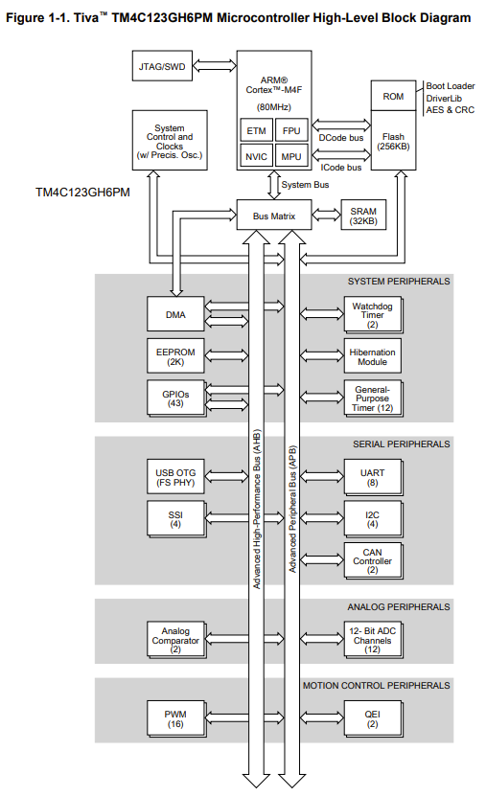
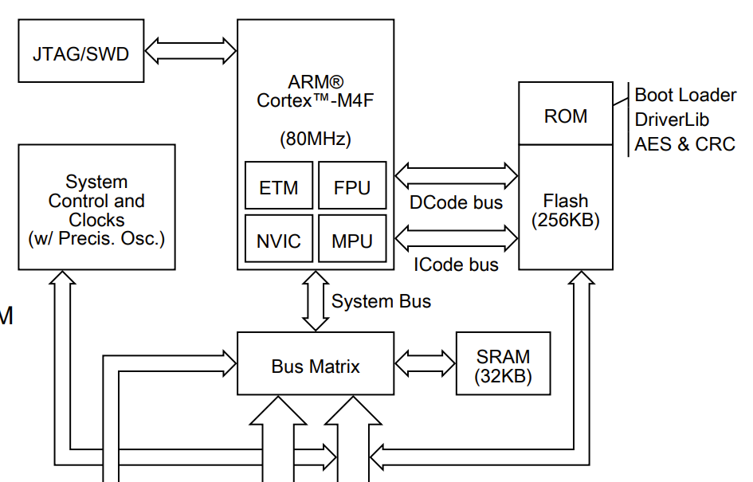
TM4C123 High-level Block Diagram
We are back

Slide 4
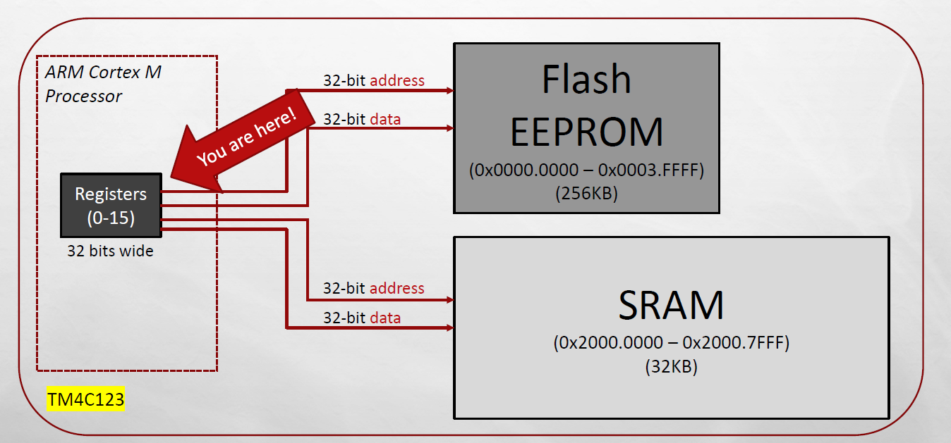
Memory layout

Slide 5
Special Purpose Register
32 bit wide
Special Purpose Register
R13: Stack Pointer (SP)
R14: Link Register (LR)
R15: Program Counter (PC)
We are here

Slide 6
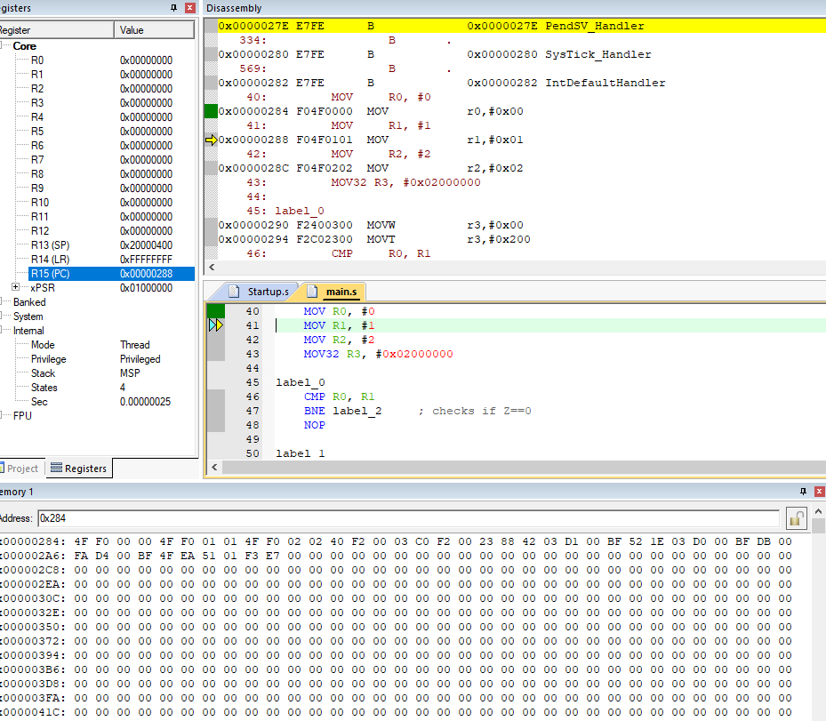
The Program Counter (PC)
Program Counter (PC)
Current location in the program
What is “location”
Location

Slide 7
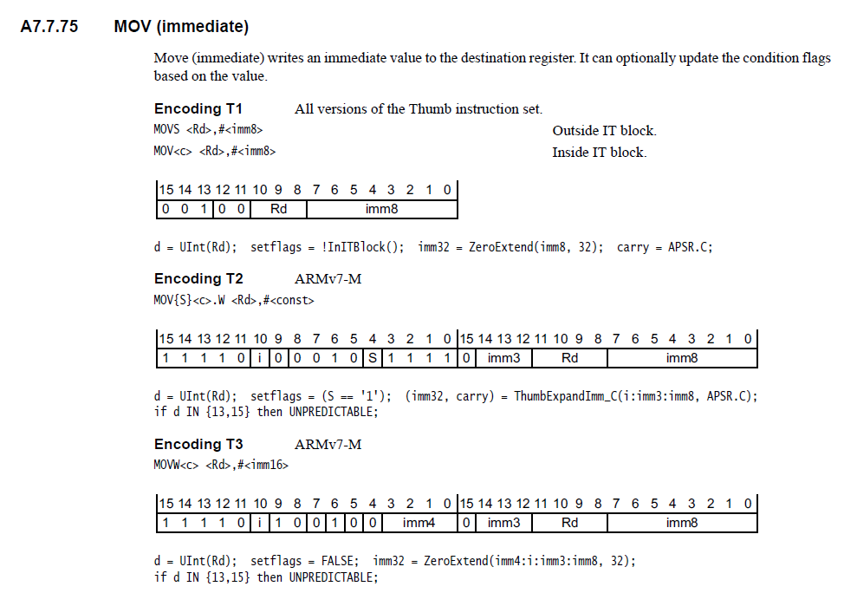
Encoding (Thumb-2)

Slide 8
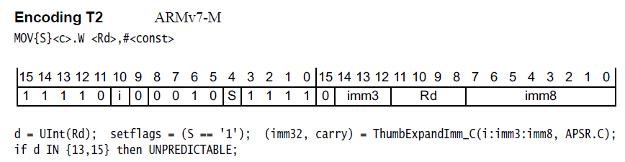
Encoding (Thumb-2)
F
0
4
F
0
1
0 1
MOV R1, #1

Slide 9
PC in action
Open class demon project
ClassDemo_PC.zip file
OR
Enter the following instructions after the start label in a blank project
MOV R0, #0
MOV R1, #1
MOV R2, #2
ADD R3, R1, R2
B skip
LSL R3, #0x2
skip
LSR R3, #0x1
NOP

Slide 10
Special Purpose Register
32 bit wide
Special Purpose Register
R13: Stack Pointer (SP)
R14: Link Register (LR)
R15: Program Counter (PC)
We are here

Slide 11
We already know how to use branch
C Code
varZ = varX + varY
Assembly Code
LDR R1, =varX
LDR R0, [R1]
LDR R1, =vary
LDR R2, [R1]
ADD R0, R0, R2
LDR R1, =varZ
STR R0, [R1]

Slide 12
Subroutines!
C Code
varZ = sum(varX, vary)
Assembly Code
LDR R1, =varX
LDR R0, [R1]
LDR R1, =vary
LDR R2, [R1]
ADD R0, R0, R2
LDR R1, =varZ
STR R0, [R1]

Slide 13
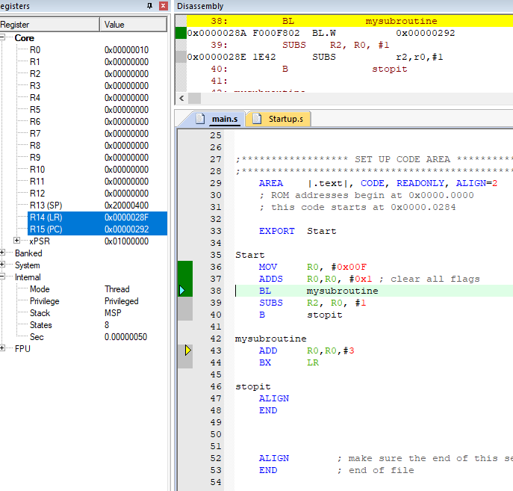
The Link Register (LR) In Action
Open class demon project
ClassDemo_LR.zip file
Enter the following instructions after start label

Slide 14
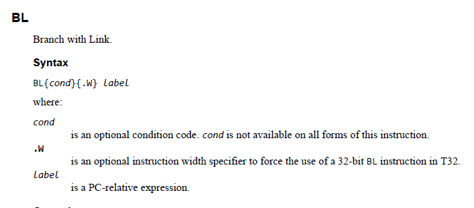
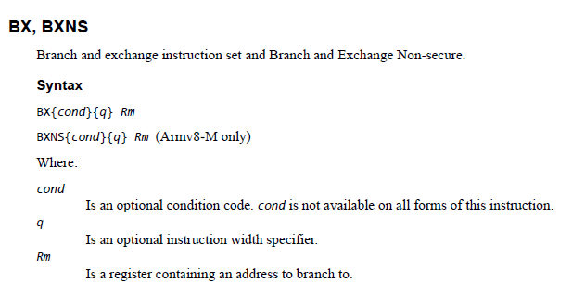
Branching With Link
BL
Causes a branch to “label” and copies the address of the instruction into LR
BX
Branch to an address contained in a register

Slide 15
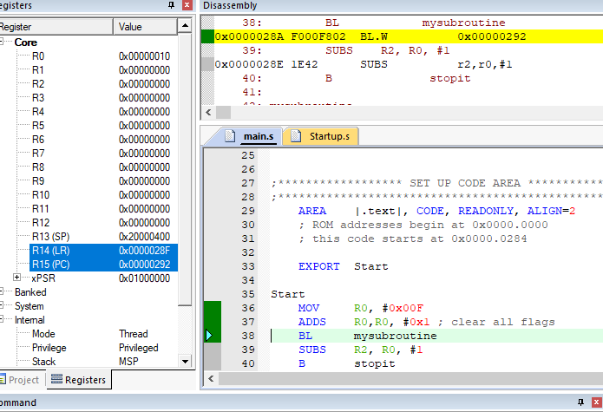
Link Register
Holds your spot while you jump to a subroutine

Slide 16
ROM
PC
LR
ARM uses bit 0 of LR register to encode execution state
bit[0] = 0 → ARM mode
bit[0] = 1 → Thumb mode
28A | 28B | 28C | 28D | 28E | 28F | 290 | 294 | 298
00 | F0 | 02 | F8 | 42 | 1E | 02 | E0
Current instruction

Slide 17
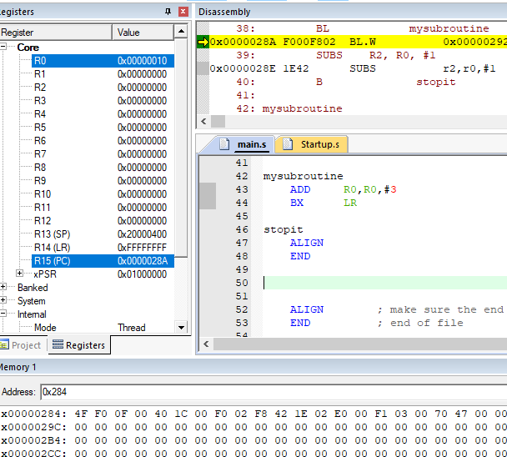
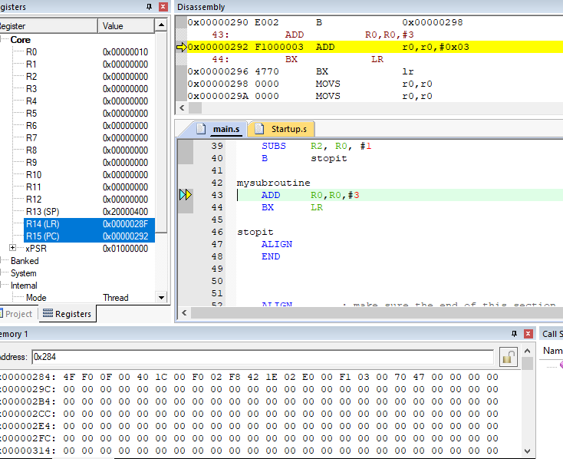
LR

Slide 18
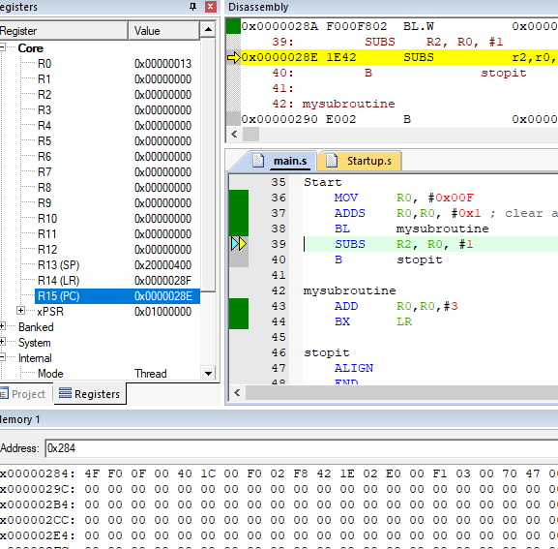
LR

Slide 19
Special Purpose Register
32 bit wide
Special Purpose Register
R13: Stack Pointer (SP)
R14: Link Register (LR)
R15: Program Counter (PC)
We are here

Slide 20
Reading From RAM
Address bus
R0
R1
R2
… | …
0x20000000 | AB | CD | EF | 12
0x20000004 | 00 | 00 | 00 | 00
0x20000008
0x2000000C
…
Data bus
Control signals
ARM Processor
Memory
LDR R1, =0x20000000
LDR R0, [R1]
LDR H R0, [R1]
LDR B R0, [R1]

Slide 21
Write A Byte To RAM
Address bus
R0
R1
R2
… | …
0x20000000 | AA | CD | EF | 12
0x20000004 | 00 | 00 | 00 | 00
0x20000008
0x2000000C
…
Data bus
Control signals
ARM Processor
Memory
LDR R1, =0x20000000
MOV32 R0, #0xDDCCBBAA
STRB R0, [R1]

Slide 22
Write A Byte To RAM
Address bus
R0
R1
R2
… | …
0x20000000 | AA | BB | CC | DD
0x20000004 | 00 | 00 | 00 | 00
0x20000008
0x2000000C
…
Data bus
Control signals
ARM Processor
Memory
LDR R1, =0x20000000
MOV32 R0, #0xDDCCBBAA
STR R0, [R1]

Slide 23
Memory MAP
0x00000000
Stack is R/W
It is in RAM
Starting value of OUR Stack Pointer = 0x20000400
What is it?
How to calculate?
Stack Pointer value → R13
256K Flash ROM
0x0003FFFF
0x20000000
32K RAM
0x20007FFF
0x40000000
I/O ports
0x400FFFFF
Internal I/O
PPB
0xE0000000
0xE0041FFF
Memory

Slide 24
Write To Stack → PUSH
Address bus
R0 | AAAA.AAAA
R1 | BBBB.BBBB
R2 | CCCC.CCCC
… | …
0x200003F0
0x200003F4
0x200003F8
0x200003FC
0x20000400
Data bus
Control signals
ARM Processor
Memory
;SP = 0x2000.0400 (empty stack)
PUSH {R0} ;SP=0x2000.03FC after PUSH
PUSH {R1} ;SP=0x2000.03F8 after PUSH
PUSH {R1} ;SP=0x2000.03F4 after PUSH

Slide 25
Write To Stack → PUSH
Address bus
R0 | AAAA.BBBB
R1 | BBBB.CCCC
R2 | CCCC.DDDD
… | …
0x200003F0 | 00 | 00 | 00 | 00
0x200003F4 | DD | DD | CC | CC
0x200003F8 | CC | CC | BB | BB
0x200003FC | BB | BB | AA | AA
0x20000400
Data bus
Control signals
ARM Processor
Memory
;SP = 0x2000.0400 (empty stack)
PUSH {R0} ;SP=0x2000.03FC after PUSH
PUSH {R1} ;SP=0x2000.03F8 after PUSH
PUSH {R2} ;SP=0x2000.03F4 after PUSH

Slide 26
Read From Stack → POP
Address bus
R0
R1
R2
… | …
0x200003F0
0x200003F4 | DD | DD | CC | CC
0x200003F8 | CC | CC | BB | BB
0x200003FC | BB | BB | AA | AA
0x20000400
Data bus
Control signals
ARM Processor
Memory
;SP = 0x2000.03F4 (current pointer)
POP {R2} ;SP=0x2000.03F8 after POP
POP {R1} ;SP=0x2000.03FC after POP
POP {R0} ;SP=0x2000.0400 after POP

Slide 27
The Stack FAQ
What is STACK
Read/Write memory. It is specifically reserved for very short-term data storage
Where is it
RAM, given it is read/write memory
How is it created?
Using directives, as configured in the Startup.s file
EQU, AREA, SPACE, __initial_sp

Slide 28
The Stack FAQ
How is it used?
Since you have very few registers, the stack can work as an extension of the register bank. But unlike registers, it is located off of the Microprocessor core (in RAM)
The stack is used with subroutines to save the state of the register bank so that subroutines can freely use the registers in their calculations.
How do you access the stack?
Through the PUSH and POP instructions.
Why is the stack so weird
Last In, First Out
It stores data backwards.

Slide 29
The Stack: Before Push
R0 | 0x00112233
R1 | 0x44556677
R2 | 0xAABBCCDD
R3 | 0x12345678
0x200003F0
0x200003F4
0x200003F8
0x200003FC
0x20000400
ARM Processor
Memory
;SP = 0x2000.0400 at reset
; Code PUSH
PUSH {R0}
PUSH {R1}
PUSH {R2}
; Code POP
POP {R2}
POP {R1}
POP {R0}

Slide 30
The Stack: After Push
R0 | 0x00112233
R1 | 0x44556677
R2 | 0xAABBCCDD
R3 | 0x12345678
0x200003F0
0x200003F4 | DD | CC | BB | AA
0x200003F8 | 77 | 66 | 55 | 44
0x200003FC | 33 | 22 | 11 | 00
0x20000400
ARM Processor
Memory
;SP = 0x2000.03F4 after PUSH
; Code PUSH
PUSH {R0}
PUSH {R1}
PUSH {R2}
; Code POP
POP {R2}
POP {R1}
POP {R0}

Slide 31
The Stack: Before POP
R0
R1
R2
R3 | 0x12345678
0x200003F0
0x200003F4 | DD | CC | BB | AA
0x200003F8 | 77 | 66 | 55 | 44
0x200003FC | 33 | 22 | 11 | 00
0x20000400
ARM Processor
Memory
;SP = 0x2000.03F4 before POP
; Code PUSH
PUSH {R0}
PUSH {R1}
PUSH {R2}
; Code POP
POP {R2}
POP {R1}
POP {R0}

Slide 32
The Stack: After POP
R0 | 0x00112233
R1 | 0x44556677
R2 | 0xAABBCCDD
R3 | 0x12345678
0x200003F0
0x200003F4 | DD | CC | BB | AA
0x200003F8 | 77 | 66 | 55 | 44
0x200003FC | 33 | 22 | 11 | 00
0x20000400
ARM Processor
Memory
;SP = 0x2000.0400 after POP
; Code PUSH
PUSH {R0}
PUSH {R1}
PUSH {R2}
; Code POP
POP {R2}
POP {R1}
POP {R0}

Slide 33
The Stack: PUSH/POP Multiple Registers
R0 | 0x00112233
R1 | 0x44556677
R2 | 0xAABBCCDD
R3 | 0x12345678
R4
0x200003F0
0x200003F4
0x200003F8
0x200003FC
0x20000400
ARM Processor
Memory
; Code PUSH
PUSH {R0-R1, R3, R2}

Slide 34
The Stack: PUSH/POP Multiple Registers
R0 | 0x00112233
R1 | 0x44556677
R2 | 0xAABBCCDD
R3 | 0x12345678
R4
0x200003F0 | 33 | 22 | 11 | 00
0x200003F4 | 77 | 66 | 55 | 44
0x200003F8 | DD | CC | BB | AA
0x200003FC | 78 | 56 | 34 | 12
0x20000400
ARM Processor
Memory
; Code
PUSH {R0-R1, R3, R2}
… …
POP {R1, R3, R2, R0}

Slide 35
The Stack: PUSH/POP Multiple Registers
R0 | 0x00112233
R1 | 0x44556677
R2 | 0xAABBCCDD
R3 | 0x12345678
R4
0x200003F0 | 33 | 22 | 11 | 00
0x200003F4 | 77 | 66 | 55 | 44
0x200003F8 | DD | CC | BB | AA
0x200003FC | 78 | 56 | 34 | 12
0x20000400
ARM Processor
Memory
; Code
PUSH {R0-R1, R3, R2}
… …
POP {R1, R3, R2, R0}

Slide 36
Stack Pointer (SP) Practice
Open class demon project
ClassDemo_PushPop.zip file

